Slide 1


CANoe FIB implementation
More Lives Saved
More Life Lived
Agapi Grigore
SWV

Slide 2
1. Needed files:
1.1 FIB_CANOE_DLL.dll → Functions for USB communication with FIB
1.2 FIB_Control.cin → Functions for CAPL scripts
1.3 FIB.vsysvar → System variables
1.4 FIB_Panel.can → Panel control functions / event (button) handlers
1.5 FIB.xvp → Panel interface
+ “Images” folder: Time_symbol.png + Voltage_symbol.png
1.6 Optional: FIB_Check folder → FIB check test
PTC location: e:/MKSProjects/SWVR_PP_CI_Activities/CANOE_Test_PLT/CANOE_FIB_Implementation
Implemented and tested on : CANoe Build 15.3.89 (SP3) – 64 bit

Slide 3
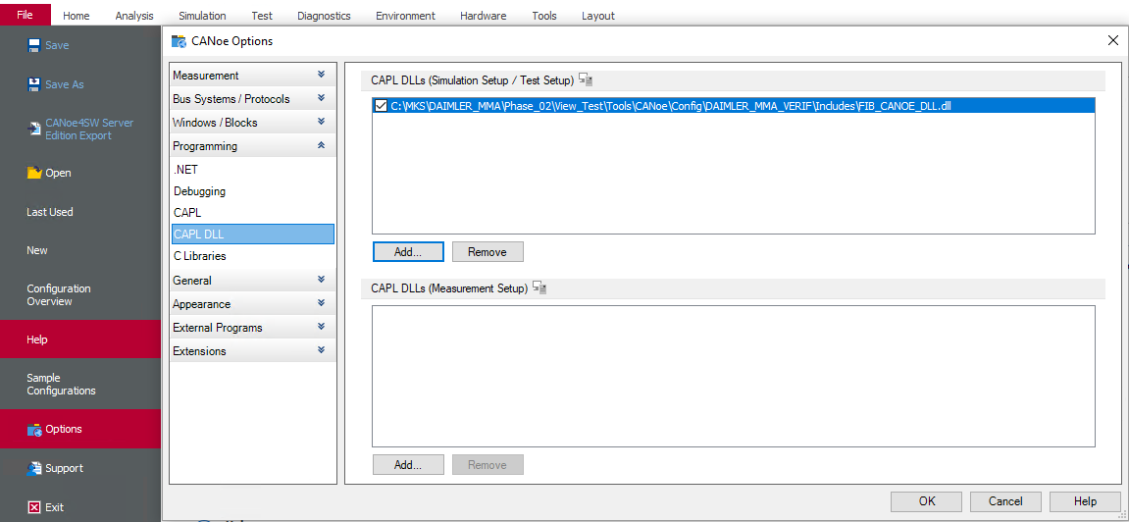
1.1 FIB_CANOE_DLL.dll
Add to CANoe configuration: File → Options → Programming → CAPL DLL → Add to “Simulation Setup / Test Setup”
1
3
4
2

Slide 4
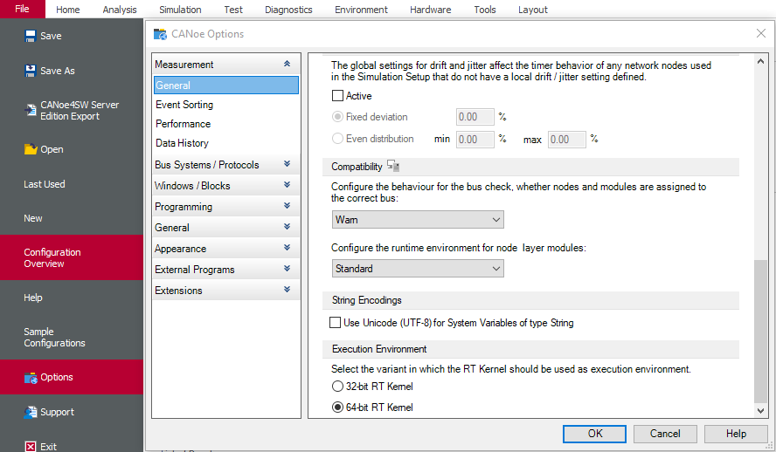
- Configure .dll Execution environment: File → Options → Measurement → General → Check 64-bit kernel
1
2

Slide 5
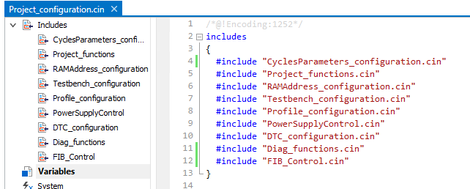
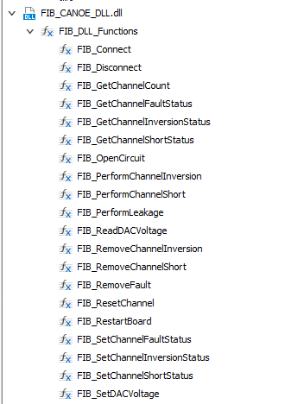
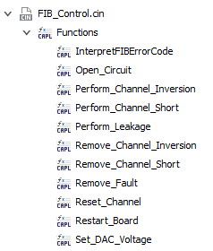
1.2 FIB_Control.cin
If you wish to access FIB functionality through CAPL scripts, this must be included, otherwise skip this step.
E.g., for DAIMLER MMA:
Only use the functions present in FIB_Control.cin module. Do NOT use the .DLL functions directly (functions that start with “FIB_...”).
Reason: FIB_Control.cin functions contain mandatory pre-checks e.g., check if a different fault is already active, etc.
FIB_Control.cin
(ok to use)
FIB_CANOE_DLL.dll
(do not use)

Slide 6
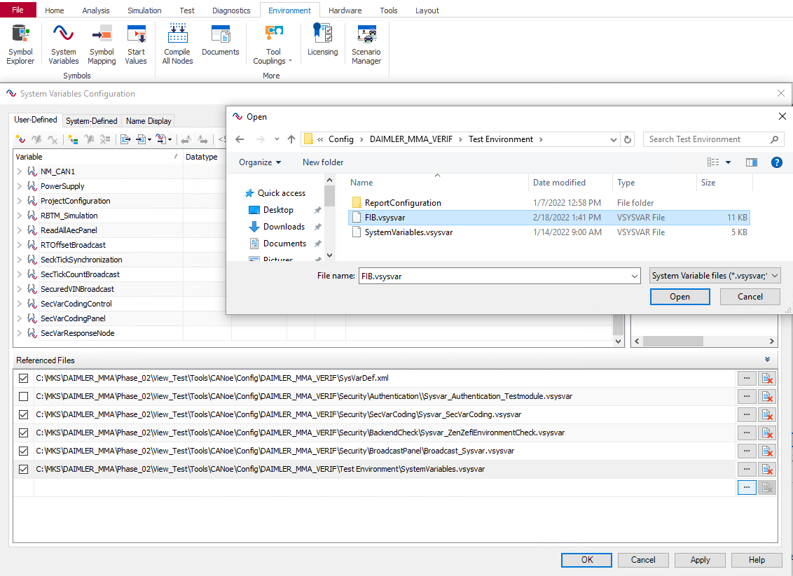
1.3 FIB.vsysvar
Import to CANoe configuration: Environment → System Variables → Select File → Open
1
2
4
5
3

Slide 7
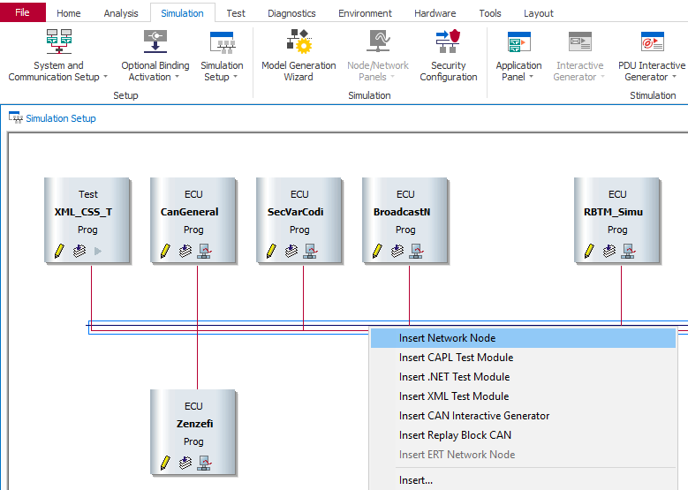
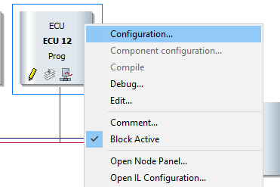
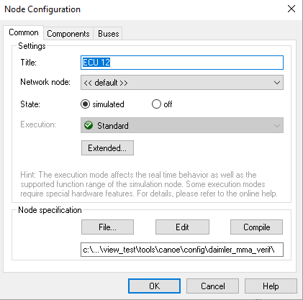
1.4 FIB_Panel.can
Add to CANoe:
Simulation → Simulation Setup → Right click on BUS → Insert Network Node
Right click the new generated node → Configuration → File → Open FIB_Panel.can
1
2
4
3
5

Slide 8
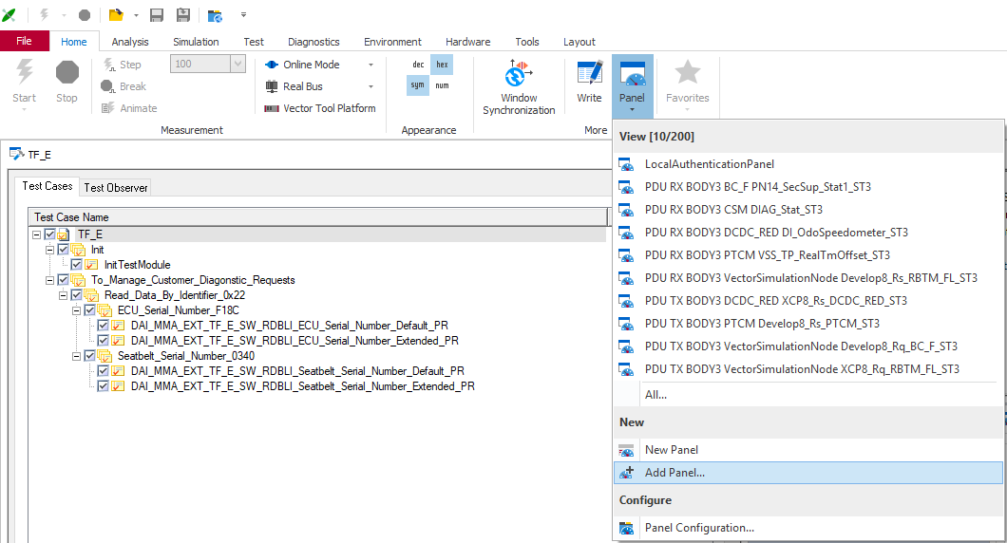
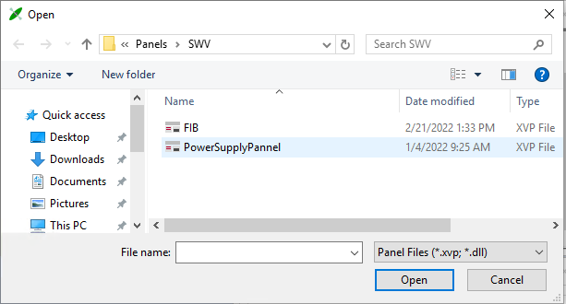
1.5 FIB.xvp
Import to CANoe configuration: Home → Panel → Add Panel…
FIB panel images will be displayed at runtime if the “Images” folder is in the same folder containing FIB.xvp e.g.,
..\Panels\FIB.xvp
..\Panels\Images\Time_symbol.png
1
2
4
3

Slide 9
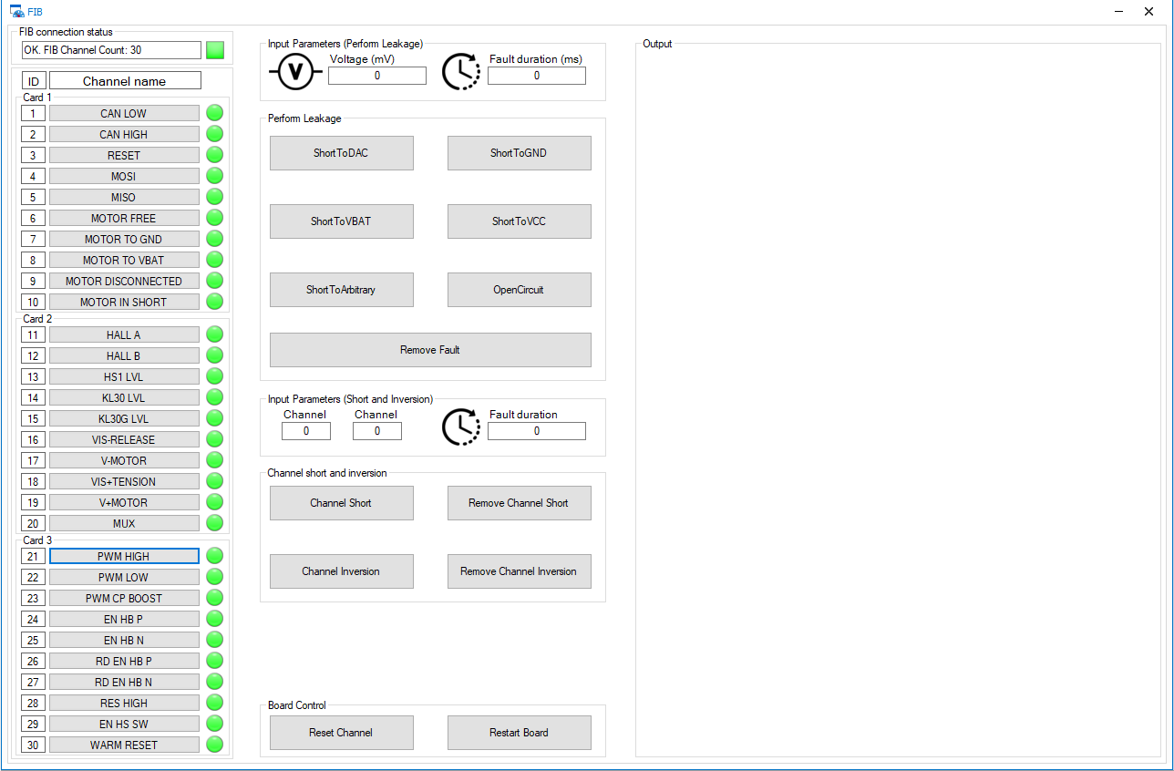
2. FIB check
A successful connection is indicated by the message: “OK. FIB Channel count: ‘your channel count’ “ after starting the simulation.

Slide 10
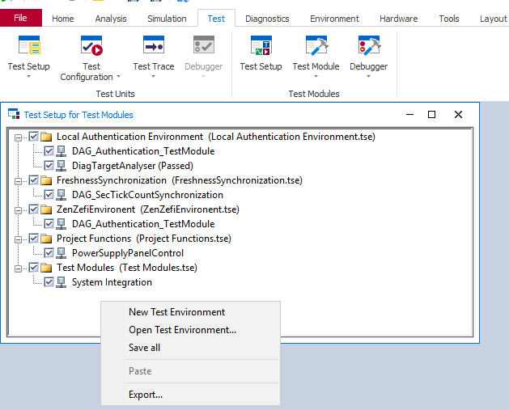
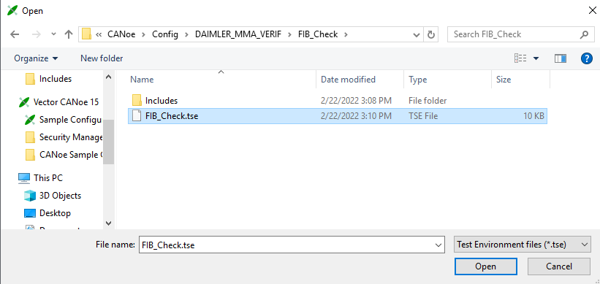
The test from ‘FIB_Check’ folder can be used to verify that the following FIB commands function properly for all channels: Open Circuit, Short to VCC, Short to GND, Set DAC Voltage, Restart_Board, Reset_Channel.
Please disconnect anything connected to the FIB output channels prior to running this test!
Test → Test Setup → Right click in test setup → Open Test Environment → Open FIB_Check.tse
1
2
4
3

Slide 11
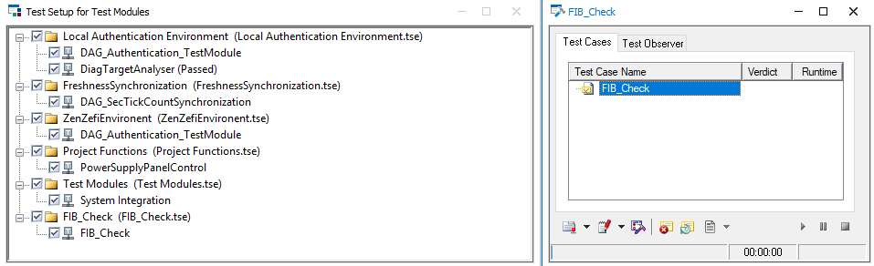
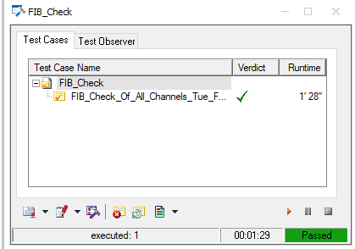
Double click on FIB_check → Run
Execution should last <2 min and a pass result looks like this
5
6

Slide 12

Saving More Lives

